Slide 1
Automatic Irrigation System

Slide 2
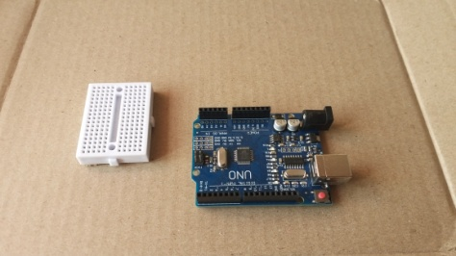
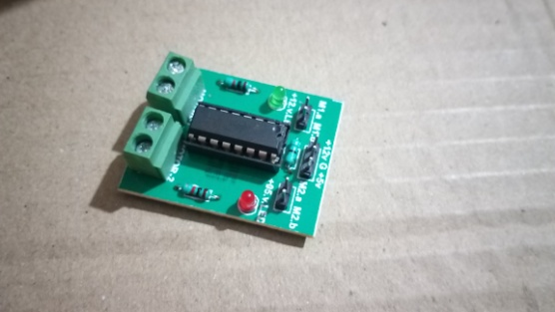
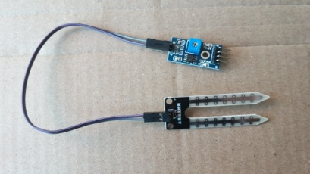
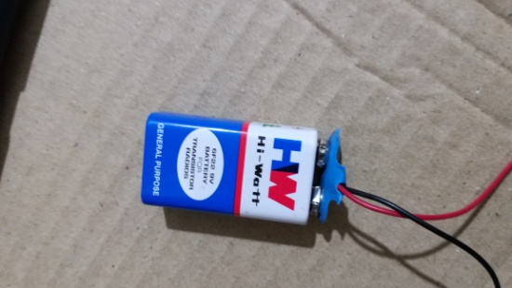
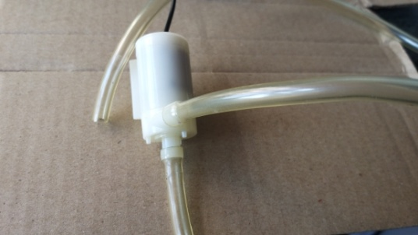
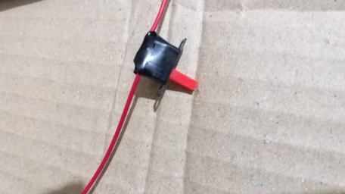
Components required
Arduino UNO
Motor driver
Soil moisture sensor
Potentiometer
Jumping wires
9v battery
Breadboard
Water pump
Switch

Slide 3

What to do ?
Connect moisture sensor to the Arduino.
Then, connect the water pump with the Arduino via motor driver. Here, motor driver will act as a switch to operate the pump, according to the signal given by the Arduino.
Make the remaining connections on breadboard to complete the circuit.

Slide 4
THE BIG IDEA
The basic task is to supply water to the soil as per need. For this, first we measure the water level in the soil. To do so, we use moisture sensor. It gives the information about it to the Arduino and as the water level goes down beyond certain level, the Arduino commands motor driver to start the pump. Hence supplying water to the soil.

Slide 5
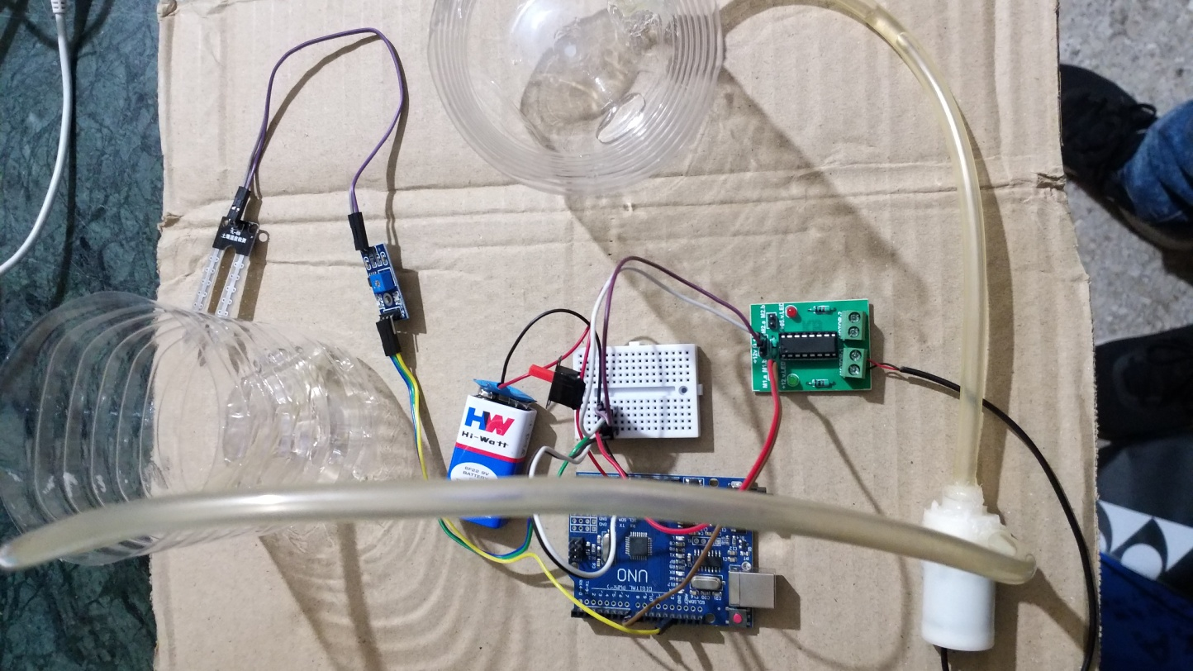
After achieving a certain water level, it again commands the motor driver to switch off the pump.

Slide 6
Thank You

